Slide 2
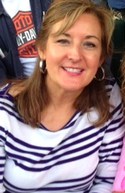
Ms. Brock’s
FAQ

Slide 3
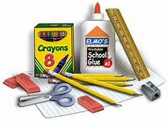
What supplies do I need for math class?
1.5” Clear View binder w/pockets (will label in class)
Pencil pouch w/basic supplies (used for all classes) glue sticks, #2 pencils, color pencils, scissors, pencil sharpener, highlighters
Small pkg. page protectors (10 needed)
Small pkg. dry erase markers (2-4)
Loose leaf paper
Composition book (will label in class)
Earbuds (cheap)
TI-34 Multiview Calculator
All materials for math will be labeled in class.

Slide 4
Where will my math supplies/work be kept?
Place the composition book in the front pocket of the 1.5” binder.
Page protectors will be used to store goal setting sheets, manipulatives, & things needed for long term.
A binder clean-out will be done at the end of each quarter. (Do not throw away papers.)

Slide 5
What should I bring to class every day?
A great ATTITUDE!
Pencil pouch with needed supplies.
Math binder with loose leaf paper,
composition book and class materials.

Slide 6
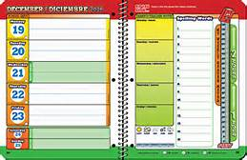
What are class guidelines for AGENDAS?
Agenda’s are required.
Fill out the agenda daily upon
entering the classroom.
Leave the agenda open at the
top of your table. Parent sign
once a week on Mon.-Thur.(no initials)
Rewards given on Friday.

Slide 7
When does class begin?
Without being prompted, class begins upon entering the classroom.
1. Write in agenda. Lay at top of table.
2.Get out math/assignments and place
at the top of your table so it is visible.
3.Complete Problem(s) of the Day.

Slide 8
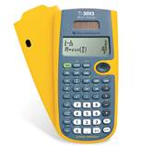
May I use a calculator?
All students will be using a TI-34
Multiview Calculator. Available at Wal-Mart.
Reminder: Calculators do not replace
showing the method used in arriving at the
answer. Be prepared to share your method.

Slide 9
What is the procedure for turning in work?
First & Last Name
Date
Class Period
Assignment
(In left corner by red line.)

Slide 10
What should homework look like?
Name. Date. Class Period. Assignment at top of the paper.
Attend to precision (one of the 8 Math Practice Standards)
Showing your method of arriving at an answer is part of the answer. Therefore, a full answer is required to get full credit.
Do not use a calculator when one is not necessary.

Slide 11
Will I be working in groups?
Group work is necessary in math.
Expectations for successful group work:
Voice level 1-2
Include everyone and their ideas
Monitor time and keep moving forward
Attend to precision

Slide 12
What happens when I’m not in class?
Follow the student handbook for make-up work guidelines.
Check the teacher website for the homework assignment. (gofiguremath.com)
Call a friend. Ask your table partner for agenda/notes.
Get handouts from Ms. Brock.
Turn in assigned work that was due when you were absent.

Slide 13
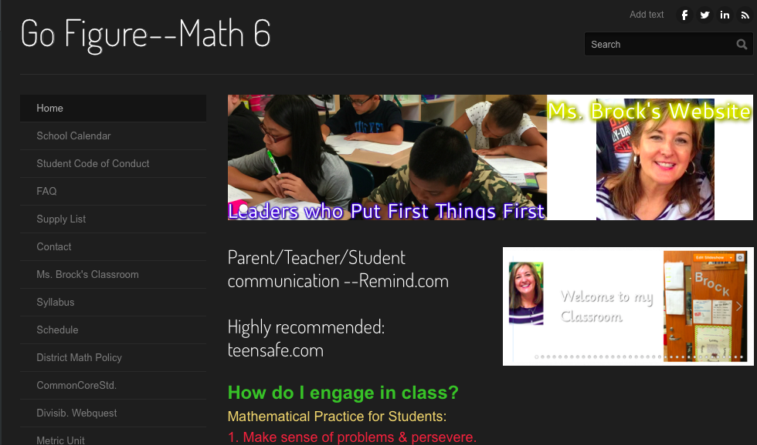
How do I find the teacher website?
Gofiguremath.com
Daily homework assignments, tutorials and often visited websites for students.

Slide 14
Will I be given study guides for the test?
Yes.
Study guides will be given in advance to help review for assessments. When nearing the end of a unit, students will be given a “heads-up” that a study guide and assessment will follow.

Slide 15
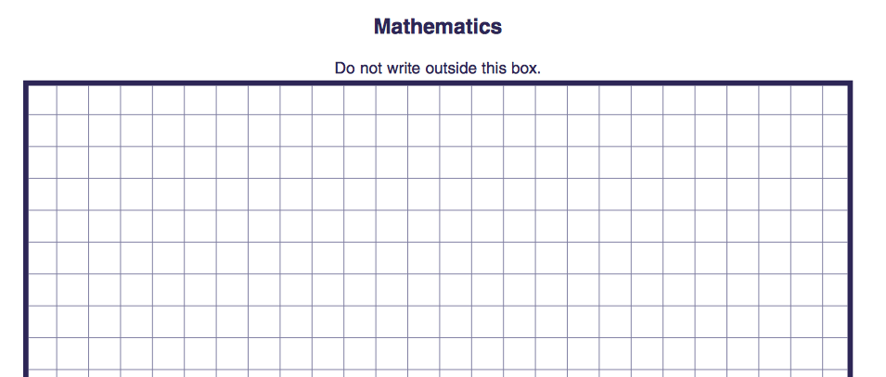
What do unit tests look like?
Unit assessments will consist of a combination of multiple-choice, short answer(s) and an extended response. Assessments are designed to complete in one class period to complete the test.

Slide 16
How is class dismissed?
When the bell rings, stay in your seat.
All materials should be returned to their proper location.
Wait for Ms. Brock’s to dismiss one section at a time & say..
HAVE A GREAT DAY!!
Push your chair up to the table.
Voice level 1.

Slide 17
Think Win-Win!!

